Slide 1

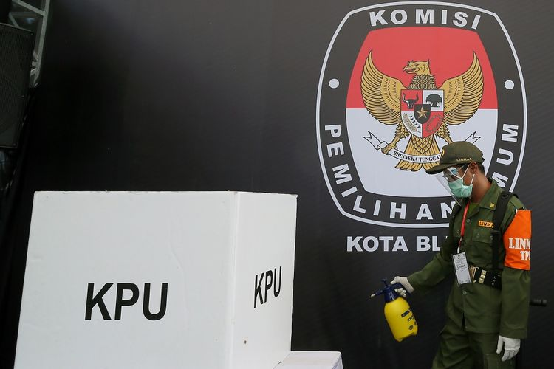
Come Hell or High Water:
The 2020 Indonesia Regional Election’s Turnout in the Time of Covid-19
Yoshua Caesar Justinus, Teguh Dartanto, Rus’an Nasrudin
Rus’an Nasrudin, Ph.D.
IBER Monthly Webinar, Feb 25, 2022

Slide 2
Introduction

Slide 3
Motivation
It is generally believed that in a functioning democracy, election plays an important role in holding the incumbents accountable and keeping democracy sustainable (Lijphart, 1997).
Having a high turnout is seen a desirable condition as it provides legitimacy for the election winners, while low turnout may not be an accurate reflection of the people’s will, presumably due to unequal representation among parts of population and possibility of voting incapable candidates which could lead to poor policymaking, affect the quality of public service, and massively impact people’s lives.
The presence of COVID-19 pandemic, however, has massively impacted the preparation of the election because of a sudden change in people’s everyday life.
In order to prevent the virus from spreading uncontrollably, elections, among many other events, had to be re-prepared. According to Institute for Democracy and Electoral Assistance (IDEA), 75 elections in countries and territories were postponed by local officials, including Indonesia.

Slide 4
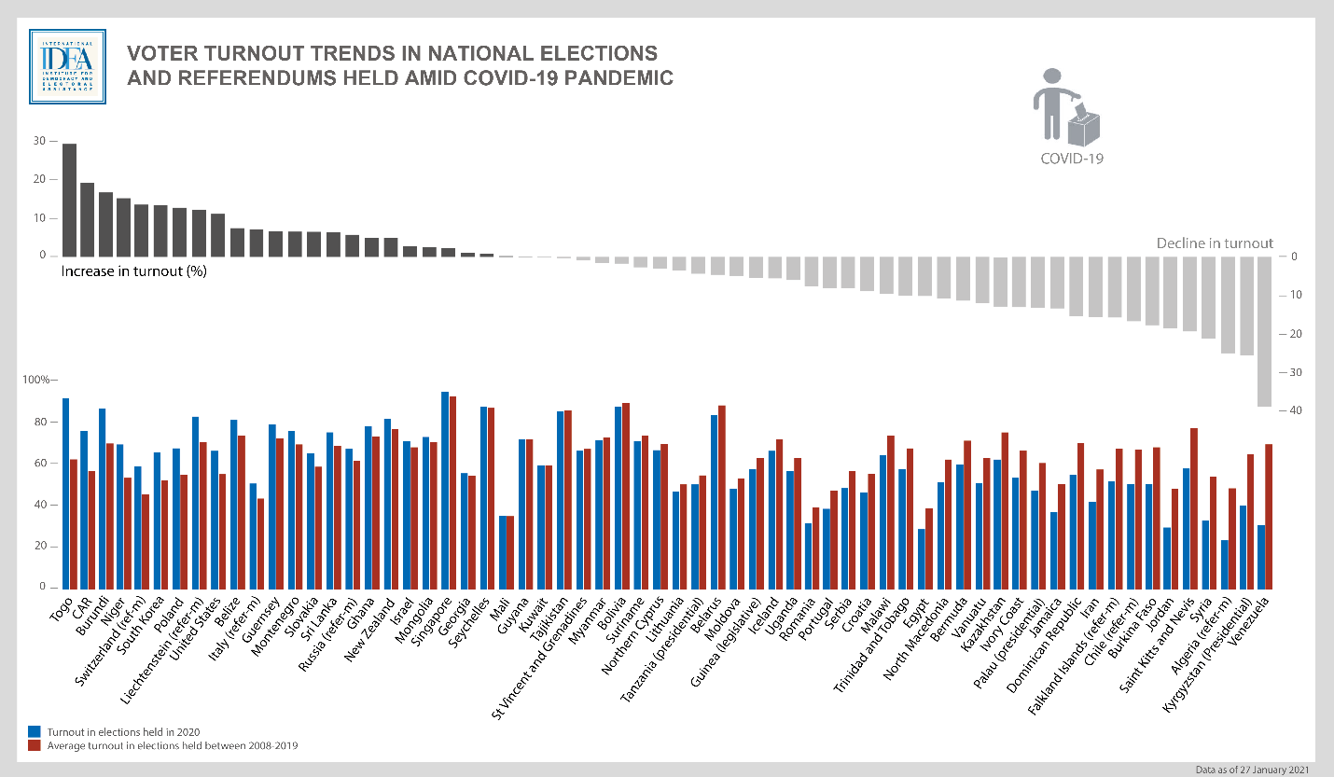
Elections Around the World in the Time of Covid-19
IDEA notes that a majority of countries and territories that held elections amid the pandemic saw a decline in turnout, resulting in increased concern regarding the legitimacy of elections.
Interestingly, there were 30 elections that saw increased turnouts. Some notable elections are Singapore, South Korea, and the United States.
Bicu & Wolf (2020) identifies 3 influential factors: ways of voting, political stakes, and election timing
Source: Institute for Democracy and Electoral Assistance (https://www.idea.int/news-media/news/going-against-trend-elections-increased-voter-turnout-during-covid-19-pandemic)

Slide 5
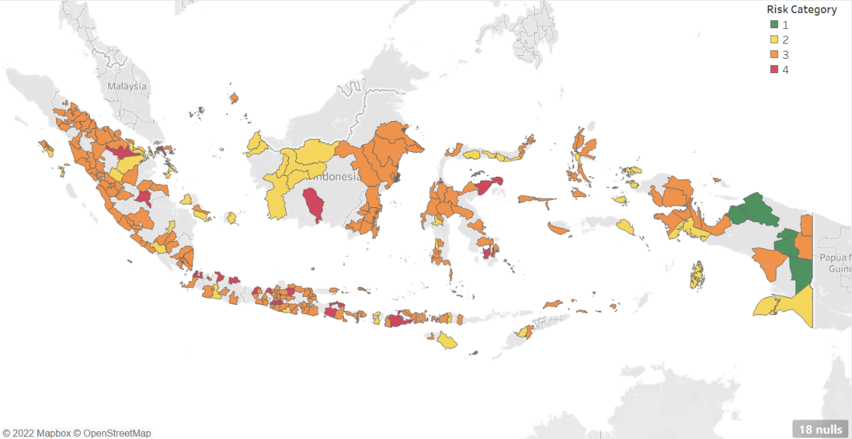
The Case of Indonesia
Initially, Indonesia’s Regional Election voting day had been planned to take place on 23rd September 2020 before President Joko Widodo’s administration decided to postpone the election to 9th December 2020, hoping the pandemic would be under control by then.
The number of cases kept increasing but the government opted against further postponement. Eventually, the elections went underway as planned, 9 months into the start of the pandemic.
Source: Authors’ Own Illustration

Slide 6
The 2020 Election Turnout
Despite initial showings that the 2020 election turnout could be low, the average turnout of 270 polities was announced in February 2021 at 76.09 percent, just 1.4 percentage points shy from the General Elections Commission target of 77.5 percent.
While the figure shows a noticeable drop by 5.9 percentage points from the all-time high of the 2019 Presidential Election, it also shows a continuing upward trend in turnout.
-5.88 pp
Source: Authors’ Own Illustration Based on Data from Indonesia’s General Elections Commission

Slide 7
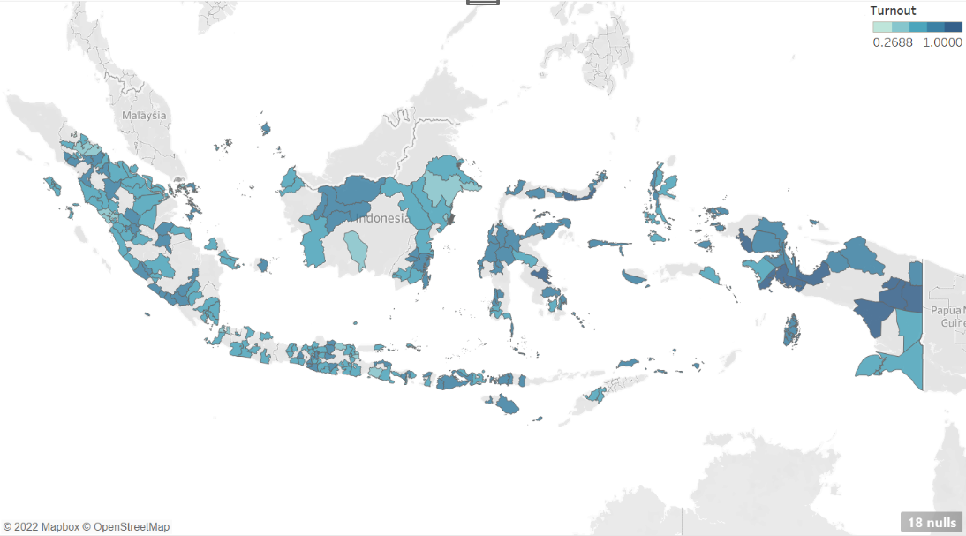
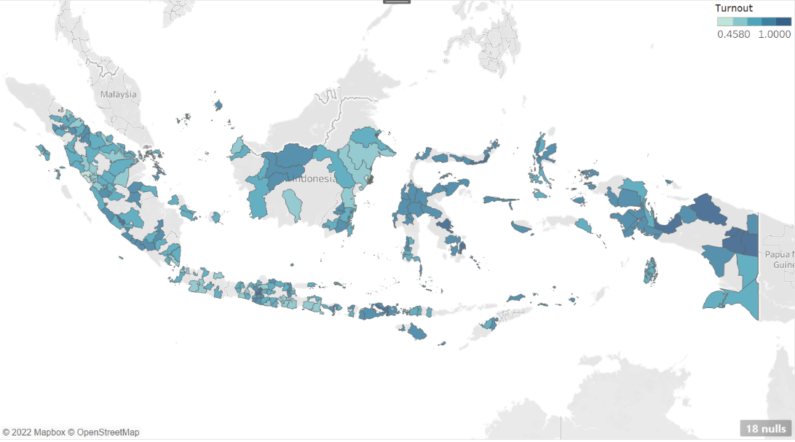
The turnout’s regional-temporal variations and Covid-19 Risk
B. Regional Election Turnout in 2015
Our identification relies on how regional turnout growth differ between two types of region: high and low risk concerning Covid-19
Outcome variations (Panel B and C) suggest a considerable size of between region’s variation and minor overtime changes of turnout, leading to a pessimistic guess of the effect
Sparsely regional distributed risk classification support for identification and less concern on spillover issues
Yet, the remaining potential issues could be present (e.g., voluntary precaution/anticipation and reverse causation effects)
A. Regional Covid-19 Risk Classification in 2020
C. Regional Election Turnout in 2020
Source: Authors’ calculation

Slide 8
Main research question
Unlike previous studies which have confirmed that election turnouts depressed significantly in times of contagious disease, the 2020 Indonesia regional election may suggest a possibility of deviation from the common trend.
The question of interest in our study: Did COVID-19, a source of increased health risks, impact the Indonesian district elections’ turnout?
Answering this question could shed a light on the behavior shown by Indonesians during a time of emergency and inform policymakers whatsoever the impact was.

Slide 9

Why People Vote
In the rational choice model of voting, each voter is assumed to calculate the costs and benefits associated with casting a ballot (Aldrich, 1993; Blais, 2000, 2006)
Downs (1957) laid a foundation for further studies by political scientists and economists in their quest to understand one’s decision whether to cast or not, that is $R=p∗\left(B\right)−C+D$. Slightly different from Downs, Harder and Krosnick (2008) came up with his own equation:
$Likelihood of voting=\frac{Motivation to Vote ×Ability to Vote}{Difficulty of Voting}$
Using the foundation Downs had laid, political scientists and economists have long tried to understand the benefits and costs associated with external shocks. An external shock can increase the benefit of voting through mobilizing effect (as in terrorism violence in Bellows and Miguel, 2009; Blattman, 2009; Robbins et al., 2013). It can also increase the cost of voting by reducing individual’s economic capacity (as in natural disasters; Sinclair et al., 2011; Rudolph and Kuhn, 2018). The effect of pandemic can fall in either one or both components, as it may reinforce the sense of duty to vote for capable leaders yet discourage voters if the health risk they face are substantially higher than the benefits and psychic satisfaction they get.

Slide 10
Underpinning hypothesis
Demographic and socioeconomic also play factor in encouraging (Geys, 2005) or discouraging (Incantalupo, 2011; Cebula, 2017) voters to vote. Whereas political variables have also been found to affect turnout (Shachar and Nalebuff, 1999; Geys, 2005; De Benedetto and De Paola, 2016; Veiga and Veiga, 2018).
Literature on COVID and Turnout
The growing literatures in this topic have generally shown that the increase of COVID cases or deaths leads to lower turnout (Fernandez-Navia et al. 2020; Santana et al., 2020; Chirwa et al., 2021; Noury et al., 2021). However, Baccini et al. (2021) find some evidence that COVID-19 incidence had a positive effect on voter turnout.
Literature on Other Infectious Disease and Turnout
Because of COVID-19 being relatively new, this study also looks up past literatures studying the effect of infectious diseases on turnout. The literatures seem to back up the COVID findings, as noted in Mexico H1N1 epidemic (Gutierrez et al., 2020) and Ebola scare in the US (Campante et al, 2020), although the study of 1918 Spanish Flu on voter 1918 Midterm Elections’ turnout suggests no impact at all (Abad and Maurer, 2021).

Slide 11
Empirical design

Slide 12
Empirical challenges
Causal inference set up for examining Covid-19 impact has been disputed around two main issues:
Decomposing the cause and effect between the infection and the containment policies
Conventional threats to estimate validity: reverse causality (restriction because of cases), unobserved (voluntary precautions), anticipation (lag and delays), spillovers (Goodman-Bacon & Marcus, 2020)
Caveats: our empirical analysis is limited to identifying the composite effects of the pandemic elements relying on the assumptions that voluntary precautions, anticipation and spillovers did not confound the main parameter of estimate on top of the fundamental parallel trend assumption.

Slide 13
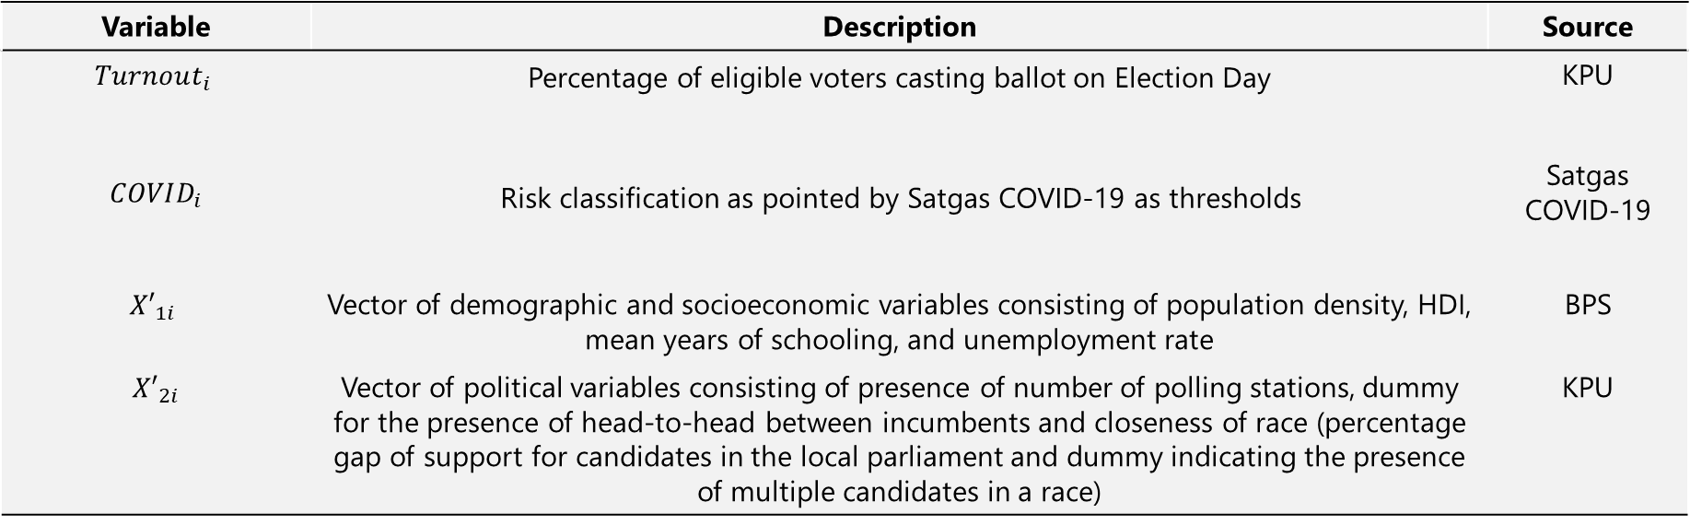
Data and variables
Data
  Types of data: Panel data in 261 municipalities and regencies that held 2020 election
Variable Description and Source
Variable | Description | Source
$$Turnout_{i}$$ | Percentage of eligible voters casting ballot on Election Day | KPU
$$COVID_{i}$$ | Risk classification as pointed by Satgas COVID-19 as thresholds | Satgas COVID-19
$${X′}_{1i}$$ | Vector of demographic and socioeconomic variables consisting of population density, HDI, mean years of schooling, and unemployment rate | BPS
$${X′}_{2i}$$ | Vector of political variables consisting of presence of number of polling stations, dummy for the presence of head-to-head between incumbents and closeness of race (percentage gap of support for candidates in the local parliament and dummy indicating the presence of multiple candidates in a race) | KPU
Source: Author’s Own Illustration

Slide 14

Estimating equations
14
Pre-estimation
In order to account for potential treatment assignment bias, we also utilized the Propensity Score Matching in this research with the Logistic function of the selection by covariates vector of $X_{i}$
$$\operatorname{Pr}\left(COVID=1 \right|X_{i})=G(\hat{θX_{i}})$$
The main estimating equation based on common support observations of above selection model, is a canonical 2x2 DiD specification adopted from Noury et al. (2021) :
$${Turnout}_{it}=β_{0}+β_{1}∗Year{2020}_{t}+β_{2}∗COVID_{i}+{β_{3} ∗Year{2020}_{t}×COVID}_{i}+X_{i}γ+ε_{it}$$
The above specification is also equivalent to a TWFE (Two-way fixed effects) model with two time period. We use interchangeably the two specifications.
This research therefore uses the estimation of PSM-DiD approach

Slide 15
Descriptive Statistics
15
 | Baseline=2015 |  |  |  |  |  | Post-Treatment=2020
Variable | Obs | Mean | Std. Dev. | Min | Max |  | Obs | Mean | Std. Dev. | Min | Max
Turnout | 261 | 0.70 | 0.1 | 0.27 | 1.00 |  | 261 | 0.76 | 0.1 | 0.46 | 1.00
Density | 261 | 813.42 | 1890.0 | 0.90 | 11133 |  | 261 | 847.45 | 1977.4 | 1.04 | 12403
Human Development Index | 261 | 66.33 | 6.2 | 39.68 | 81.65 |  | 261 | 68.14 | 6.0 | 43.24 | 83.01
Unemployment Rate | 261 | 0.052 | 0.03 | 0.00 | 0.15 |  | 261 | 0.053 | 0.02 | 0.01 | 0.16
Mean Years of Schooling | 261 | 7.71 | 1.5 | 2.06 | 11.57 |  | 261 | 8.28 | 1.4 | 2.79 | 11.81
Number of Running Lists | 261 | 3.10 | 1.1 | 1 | 8 |  | 261 | 2.73 | 1.0 | 1 | 5
Number of Polling Stations | 261 | 876 | 873.0 | 45 | 5246 |  | 261 | 1052 | 1104.7 | 59 | 6872
Coalition Gap | 261 | 18.35 | 19.6 | 0.0 | 100 |  | 261 | 30.35 | 29.3 | 0.0 | 100

Slide 16
Descriptive Statistics
16
Zoning Classification according to Satgas COVID-19 | Number of Polities
Red | 24
Orange | 186
Yellow | 44
Green | 7
210 (80%) of the polities studied were considered in the high-risk regions by the Satgas COVID-19
The turnout trend between polities categorized in treatment and control shows an indication of null effect

Slide 17
Results

Slide 18
Pre-estimation
18
Region of common support lies between 0.06 - 1
Treatment = 72.58% and Control = 27.42%
Matching process results in 75 off-support observations, leaving us with 186 observations for each period to proceed to the next regression

Slide 19
Baseline Descriptive Statistics After Matching
19
 | Control |  |  |  |  |  | Treatment |  |  |  |  |  | Differences (C –T)
Variable | Obs | Mean | Std. Dev. | Min | Max |  | Obs | Mean | Std. Dev. | Min | Max |  | Mean | t-stat | Pr(|T| > |t|)
Turnout | 51 | 0.74 | 0.11 | 0.55 | 1.00 |  | 135 | 0.71 | 0.09 | 0.50 | 0.99 |  | 0.03 | 1.91 | 0.06
Density | 51 | 101.92 | 154.92 | 0.90 | 825.03 |  | 135 | 119.82 | 132.94 | 1.70 | 680.47 |  | -17.91 | -0.78 | 0.44
Human Development Index | 51 | 61.58 | 5.35 | 44.21 | 70.00 |  | 135 | 65.09 | 3.78 | 45.91 | 72.48 |  | -3.50 | -5.00 | 0.00
Mean Years of Schooling | 51 | 6.76 | 1.28 | 2.08 | 8.91 |  | 135 | 7.54 | 0.89 | 4.38 | 9.57 |  | -0.77 | -4.66 | 0.00
Unemployment Rate | 51 | 0.044 | 0.03 | 0.001 | 0.101 |  | 135 | 0.051 | 0.03 | 0.002 | 0.117 |  | -0.006 | -1.46 | 0.15
Number of Polling Stations | 51 | 532.59 | 571.98 | 103 | 3921 |  | 135 | 647.36 | 621.39 | 45 | 4091 |  | -114.77 | -1.15 | 0.25
Coalition Gap | 51 | 15.24 | 13.29 | 0 | 60 |  | 135 | 17.57 | 18.18 | 0 | 80 |  | -2.33 | -0.83 | 0.40
Number of Running Lists | 51 | 2.96 | 0.98 | 1 | 6 |  | 135 | 3.30 | 1.13 | 1 | 8 |  | -0.34 | -1.88 | 0.06

Slide 20
Estimation Results of Binary Status
20
Variable | Without matching |  |  |  |  | With matching
 | (1) | (2) | (3) | (4) |  | (5) | (6) | (7) | (8)
Year 2020 | 0.057*** | 0.054*** | 0.036** | 0.033** |  | 0.055*** | 0.055*** | 0.040** | 0.042**
 | (0.013) | (0.014) | (0.016) | (0.017) |  | (0.015) | (0.015) | (0.017) | (0.018)
COVID | -0.380*** | -0.370*** | -0.457*** | -0.444*** |  | -0.376*** | -0.367*** | -0.425*** | -0.408***
Baseline: low risk | (0.027) | (0.026) | (0.054) | (0.054) |  | (0.041) | (0.039) | (0.058) | (0.058)
Year 2020 x COVID | 0.005 | 0.006 | 0.007 | 0.007 |  | 0.008 | 0.009 | 0.008 | 0.009
 | (0.014) | (0.014) | (0.014) | (0.014) |  | (0.014) | (0.014) | (0.014) | (0.014)
Density | -0.000004 | -0.000003 | -0.00000 | 0.00000 |  | 0.00003 | 0.00004 | 0.00003 | 0.00004
 | (0.00003) | (0.00003) | (0.00003) | (0.00003) |  | (0.00015) | (0.00014) | (0.00016) | (0.00014)
HDI | 0.003 | 0.003* |  |  |  | 0.002 | 0.002
 | (0.002) | (0.0017) |  |  |  | (0.003) | (0.003)
Mean Years of Schooling |  |  | 0.0420** | 0.0424** |  |  |  | 0.031 | 0.0283
 |  |  | (0.020) | (0.020) |  |  |  | (0.022) | (0.022)
Unemployment Rate | -0.0745 | -0.0578 | -0.0512 | -0.0332 |  | -0.0126 | -0.0293 | -0.00771 | -0.0209
 | (0.249) | (0.253) | (0.249) | (0.252) |  | (0.301) | (0.300) | (0.297) | (0.296)
Municipality Dummy | -0.226*** | -0.215*** | -0.460*** | -0.444*** |  | -0.217*** | -0.207*** | -0.378** | -0.347**
 | (0.041) | (0.039) | (0.141) | (0.141) |  | (0.062) | (0.060) | (0.151) | (0.150)
Number of Polling Stations | 0.00002 | 0.00002 | 0.00002 | 0.00002 |  | 0.00002 | 0.00002 | 0.00003 | 0.00002
 | (0.00002) | (0.00002) | (0.00002) | (0.00002) |  | (0.00003) | (0.00003) | (0.00003) | (0.00003)
Incumbents Head-to-Head Dummy | -0.012 | -0.014 | -0.014 | -0.015 |  | -0.013 | -0.013 | -0.013 | -0.013
 | (0.010) | (0.010) | (0.001) | (0.010) |  | (0.011) | (0.011) | (0.011) | (0.010)
Coalition Gap | -0.0004** |  | -0.0004** |  |  | -0.0003 |  | -0.0003
 | (0.0002) |  | (0.0002) |  |  | (0.0002) |  | (0.0002)
Multiple Candidates Dummy |  | 0.043*** |  | 0.044*** |  |  | 0.046** |  | 0.044**
 |  | (0.015) |  | (0.014) |  |  | (0.019) |  | (0.019)
Constant | 0.881*** | 0.803*** | 0.906*** | 0.838*** |  | 0.881*** | 0.816*** | 0.916*** | 0.865***
 | (0.079) | (0.074) | (0.046) | (0.046) |  | (0.124) | (0.121) | (0.051) | (0.051)
Municipality-Regency Fixed Effect | YES | YES | YES | YES
R-Squared | 0.919 | 0.92 | 0.921 | 0.922 |  | 0.912 | 0.915 | 0.913 | 0.915
Observations | 522 | 522 | 522 | 522 |  | 372 | 372 | 372 | 372
Robust standard errors in parentheses *** p<0.01, ** p<0.05, * p<0.1; Source: Authors' estimations

Slide 21
Estimation Results of Four Classification Status
21
Variable | Without matching |  |  |  |  | With Matching
 | (1) | (2) | (3) | (4) |  | (5) | (6) | (7) | (8)
Year 2020 | 0.045* | 0.047* | 0.019 | 0.021 |  | 0.044* | 0.049* | 0.026 | 0.032
 | (0.025) | (0.025) | (0.026) | (0.026) |  | (0.026) | (0.025) | (0.028) | (0.028)
Low Risk | -0.401*** | -0.389*** | -0.609*** | -0.590*** |  | -0.391*** | -0.379*** | -0.531*** | -0.497***
 | (0.043) | (0.042) | (0.129) | (0.129) |  | (0.063) | (0.061) | (0.138) | (0.138)
Moderate Risk | -0.386*** | -0.373*** | -0.469*** | -0.451*** |  | -0.379*** | -0.369*** | -0.432*** | -0.412***
 | (0.028) | (0.027) | (0.057) | (0.057) |  | (0.040) | (0.039) | (0.060) | (0.060)
High Risk | -0.354*** | -0.342*** | -0.537*** | -0.519*** |  | -0.358*** | -0.348*** | -0.479*** | -0.450***
 | (0.042) | (0.041) | (0.114) | (0.115) |  | (0.062) | (0.061) | (0.122) | (0.123)
Baseline No Risk
Year 2020 x Low Risk | 0.013 | 0.007 | 0.019 | 0.013 |  | 0.012 | 0.007 | 0.017 | 0.011
 | (0.0285) | (0.0283) | (0.0267) | (0.0264) |  | (0.0297) | (0.0293) | (0.0279) | (0.028)
Year 2020 x Moderate Risk | 0.016 | 0.012 | 0.023 | 0.019 |  | 0.018 | 0.013 | 0.022 | 0.017
 | (0.026) | (0.025) | (0.023) | (0.023) |  | (0.027) | (0.026) | (0.025) | (0.024)
Year 2020 x High Risk | 0.016 | 0.014 | 0.022 | 0.019 |  | 0.035 | 0.033 | 0.037 | 0.035
 | (0.030) | (0.030) | (0.027) | (0.028) |  | (0.038) | (0.038) | (0.036) | (0.037)
Density | -0.000004 | -0.000003 | 0.000000 | 0.000001 |  | 0.00003 | 0.000037 | 0.000028 | 0.00003
 | (0.00003) | (0.00003) | (0.00003) | (0.00003) |  | (0.00016) | (0.00014) | (0.00016) | (0.00014)
HDI | 0.003 | 0.003* |  |  |  | 0.002 | 0.002
 | (0.0017) | (0.0017) |  |  |  | (0.0028) | (0.0027)
Mean Years of Schooling |  |  | 0.043** | 0.043** |  |  |  | 0.031 | 0.028
 |  |  | (0.020) | (0.020) |  |  |  | (0.022) | (0.022)
Unemployment Rate | -0.07 | -0.056 | -0.044 | -0.029 |  | -0.012 | -0.032 | -0.005 | -0.021
 | (0.251) | (0.254) | (0.251) | (0.253) |  | (0.302) | (0.302) | (0.298) | (0.297)
Municipality Dummy | 0.168*** | 0.171*** | 0.132*** | 0.135*** |  | 0.170*** | 0.169*** | 0.144*** | 0.146***
 | (0.006) | (0.006) | (0.017) | (0.017) |  | (0.013) | (0.012) | (0.021) | (0.021)
Number of Polling Stations | 0.000016 | 0.00002 | 0.000016 | 0.00002 |  | 0.000024 | 0.00002 | 0.000025 | 0.00002
 | (0.00002) | (0.00002) | (0.00002) | (0.00002) |  | (0.00003) | (0.00003) | (0.00003) | (0.00003)
Incumbents Head-to-Head Dummy | -0.012 | -0.014 | -0.014 | -0.015 |  | -0.012 | -0.012 | -0.012 | -0.013
 | (0.0098) | (0.0098) | (0.0096) | (0.0096) |  | (0.0108) | (0.0108) | (0.0107) | (0.0107)
Coalition Gap | -0.0004** |  | -0.0004** |  |  | -0.0002 |  | -0.0002
 | (0.0002) |  | (0.0002) |  |  | (0.0002) |  | (0.0002)
Multiple Candidates Dummy |  | 0.042*** |  | 0.043*** |  |  | 0.045** |  | 0.043**
 |  | (0.015) |  | (0.015) |  |  | (0.020) |  | (0.020)
Constant | 0.888*** | 0.808*** | 0.912*** | 0.843*** |  | 0.887*** | 0.820*** | 0.922*** | 0.871***
 | (0.078) | (0.076) | (0.045) | (0.046) |  | (0.125) | (0.124) | (0.050) | (0.051)
Observations | 522 | 522 | 522 | 522 |  | 372 | 372 | 372 | 372
R-squared | 0.919 | 0.92 | 0.921 | 0.922 |  | 0.912 | 0.915 | 0.913 | 0.916
Robust standard errors in parentheses *** p<0.01, ** p<0.05, * p<0.1

Slide 22
Placebo Regression
22
 | (1) | (2)
VARIABLES | Mean Years of Schooling | Coalition Gap
Year 2020 | 0.627*** | 9.391
 | (0.0550) | (9.519)
COVID | 2.685*** | -42.11
 | (0.0489) | (31.90)
Year 2020 x COVID | -0.0691 | 2.243
 | (0.0588) | (6.397)
Density | -0.000107 | -0.00180
 | (0.000105) | (0.0121)
Unemployment Rate | -0.441 | -62.08
 | (1.113) | (147.4)
Municipality Dummy | 6.922*** | -51.46
 | (0.0629) | (81.29)
Number of Polling Stations | 1.04e-05 | 0.00326
 | (7.31e-05) | (0.00919)
Incumbents Head-to-Head Dummy | 0.0288 | -0.875
 | (0.0458) | (4.219)
Coalition Gap | 3.41e-05
 | (0.000685)
Mean Years of Schooling |  | 0.587
 |  | (11.78)
Constant | 2.109*** | 53.66**
 | (0.0541) | (25.32)
Observations | 522 | 522
R-squared | 0.993 | 0.597
Robust standard errors in parentheses *** p<0.01, ** p<0.05, * p<0.1
We use the placebo test to defend that the validity of parallel trend assumption holds (Gertler et al., 2016)
  In this setup, any variable unaffected by the treatment can serve as outcome variable: education and political coalition.
Should we find no impact, then we can be certain that the parallel trend is upheld.
Moreover, we also attribute the test to casually anticipating the potential confounding effect from precaution (education) and reverse causation (political factor), we perform placebo outcome tests

Slide 23
Discussion
23
The analysis reveals an interesting yet unsurprising finding: COVID does not seem to have any impact on 2020 regional elections’ turnout.
Possible reason #1: minimum concern regarding public health risk
  BPS-SI and SMRC reveal the indifferent attitude shown by many Indonesians toward the pandemic situation;
  Fewer people were fearful of becoming infected;
  Suspicion of under-reporting due to low contact tracing and lack of laboratories;
  People’s underestimation of the true extent of COVID-19 spread → many people went outside during long holidays in late May, October and December;
  Frustration due to uncertainty surrounding the end of the pandemic → pandemic fatigue;
  The incidence did not even peak until late January-early February.
Possible reason #2: unique localities of Indonesia’s vote buying practices might play a role
  KPK and Bawaslu warned the increasing potential vote buying. A survey finds that 70 percent of respondents had their income depleted. Consequently, there was an increasing tolerance attitude toward vote buying;
  There were 166 alleged violations of money politics in 2020 Election, 62 of which are in further investigation.

Slide 24
Conclusion

Slide 25
Concluding Remarks
25
Using impact evaluation approach, this study finds no significant impact of the COVID-19 pandemic on the 2020 Indonesian Regional Elections’ turnout, consistent across different specifications. So far, this finding is different from cases of other countries.
The rationale behind the insignificant impact lies in two possible reasons: low concern regarding health risk as indicated by various surveys and government officials
  And increasing trend of vote buying practices possible to become underlying mechanism but we leave the investigation for further study.
This study, however, is by no means perfect.
  This research goes under the assumption that the official COVID incidences figures contain the true numbers.
  Whereas, it has been proved that there is a large disparity between the official figures and the suggestive numbers in a new study conducted by a group of epidemiologists, potentially changing the dynamics of incidences in the polities studied.

Slide 26
Estimation Results of First Differenced specification (with matching)
26
 | (1) | (2) | (3) | (4)
VARIABLES | PSM-FD 1 | PSM-FD 2 | PSM-FD 3 | PSM-FD 4
Δ Time | 0.0550*** | 0.0545*** | 0.0402*** | 0.0416***
 | (0.0106) | (0.0108) | (0.0118) | (0.0123)
Δ COVID | 0.00798 | 0.00872 | 0.00846 | 0.00905
 | (0.0100) | (0.0100) | (0.00988) | (0.00990)
Δ Density | 3.30e-05 | 3.81e-05 | 3.17e-05 | 3.65e-05
 | (0.000106) | (9.44e-05) | (0.000109) | (9.78e-05)
Δ HDI | 0.00231 | 0.00244
 | (0.00195) | (0.00189)
Δ Mean Years of Schooling |  |  | 0.0310** | 0.0283*
 |  |  | (0.0153) | (0.0152)
Δ Unemployment | -0.0126 | -0.0293 | -0.00771 | -0.0209
 | (0.211) | (0.210) | (0.208) | (0.207)
Δ Number of Polling Stations | 2.37e-05 | 1.87e-05 | 2.53e-05 | 2.03e-05
 | (2.19e-05) | (2.04e-05) | (2.17e-05) | (2.02e-05)
Δ Incumbents Head-to-Head | -0.0125* | -0.0131* | -0.0128* | -0.0134*
 | (0.00742) | (0.00737) | (0.00734) | (0.00730)
Δ Coalition Gap | -0.000260* |  | -0.000251*
 | (0.000153) |  | (0.000150)
Δ Multiple Candidates |  | 0.0460*** |  | 0.0439***
 |  | (0.0135) |  | (0.0134)
Constant | 0.559*** | 0.504*** | 0.478*** | 0.454***
 | (0.125) | (0.121) | (0.114) | (0.114)
Observations | 372 | 372 | 372 | 372
R-squared | 0.566 | 0.580 | 0.572 | 0.585
Number of Polities | 186 | 186 | 186 | 186
Robust standard errors in parentheses
*** p<0.01, ** p<0.05, * p<0.1

